Slide 1

PLC and Digital Twin

Slide 2
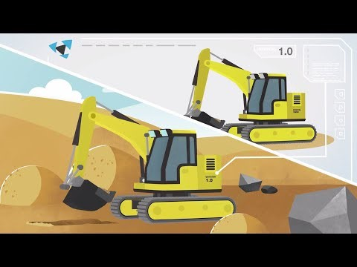
https://youtu.be/fEI5oz33Ia8

Slide 3
What is Digital Twin?
Virtual copy of the physical machine
Digital copy that look and behave exactly with the physical machine
A digital twin controlled by a PLC reacts in a similar way that a physical machine would react
Digital copy could exist before physical machine
Digital twin can run simultaneously with the physical machine
Data from physical machine gathered and used for future improvement
CAD Model
+
Simulation
PLC
+
SCADA
Digital Twin
https://pdfs.semanticscholar.org/6165/4730d24f1ba0e34b5830d2925febbf3c24fc.pdf

Slide 4
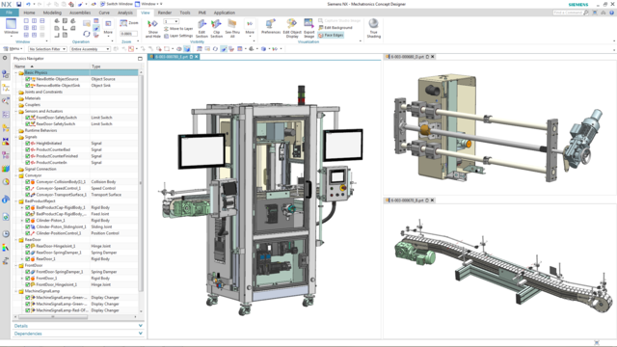
CAD Model + Simulation
Physics-Based Simulation
Computer Aided Design (CAD) is used for drafting and design
Powerful CAD software for digital twin features:
Geometry and modelling of parts
Model operation of machine
Provision to include data such as joints, motion, sensors, actuators, collision behaviour and other kinematic & dynamic properties of components
Physics-based interactive simulation to verify machine operation
https://www.plm.automation.siemens.com/global/en/products/mechanical-design/mechatronic-concept-design.html

Slide 5
Virtual Commissioning
Commissioning is to bring a newly produced product or equipment into working condition (as per Oxford dictionary)
Traditionally physical equipment or machine needs to be present during commissioning
Programmed PLC could only be tested according to specifications and simulated inputs/outputs prior to integration with physical equipment
Virtual Commissioning (VC) allows PLC program to be verified with the Digital Twin’s virtual model
PLC simulation communicates with CAD simulation in the digital twin virtual commissioning

Slide 6
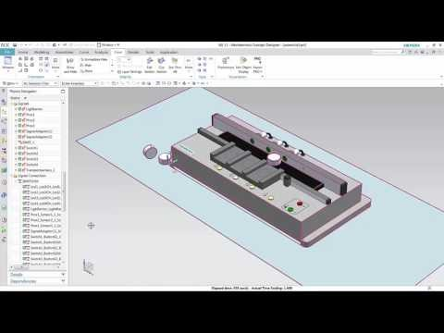
https://youtu.be/l_ePLMV7NnA

Slide 7
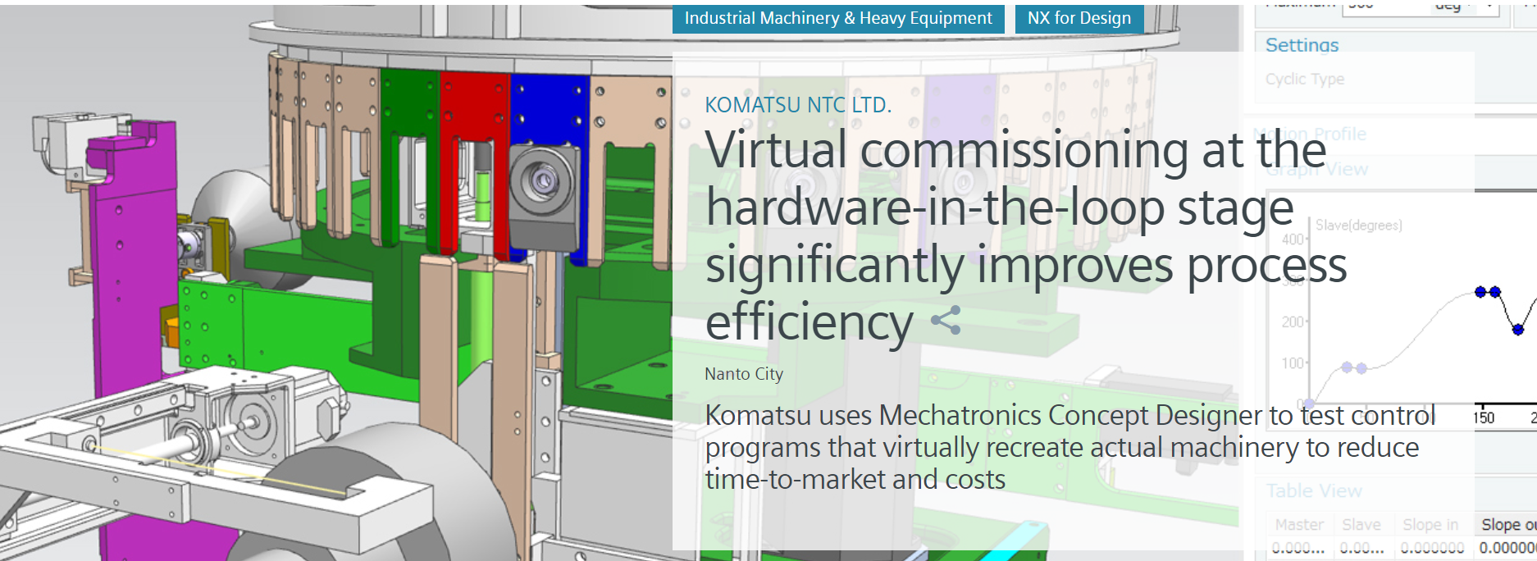
Advantages of Virtual Commissioning
Enable engineers to test, refine and optimize (Before hardware assembly):
Mechanical
Electrical
Logical Design
Integration
Significantly Reduce
Development time (time to market)
Cost of error (Errors corrected during VC)
Setup time (Issues resolved during VC)
Downtime (Unforeseen bugs resolved during VC)
https://www.plm.automation.siemens.com/global/en/our-story/customers/komatsu-ntc/12189/

Slide 8

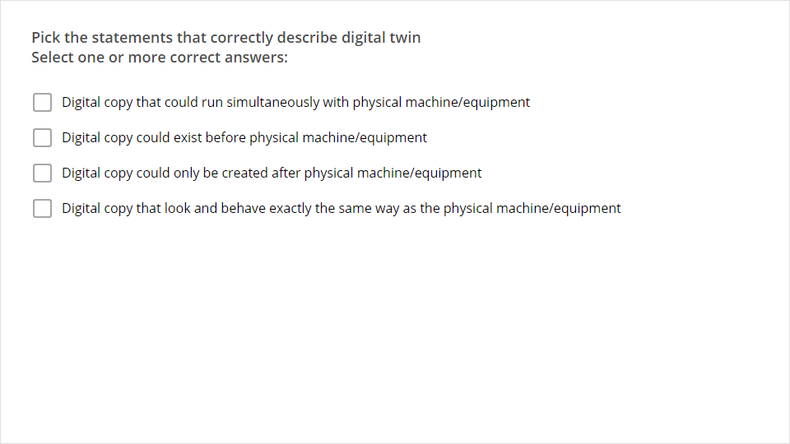
Quiz
Click the Quiz button to edit this object

